Slide 1
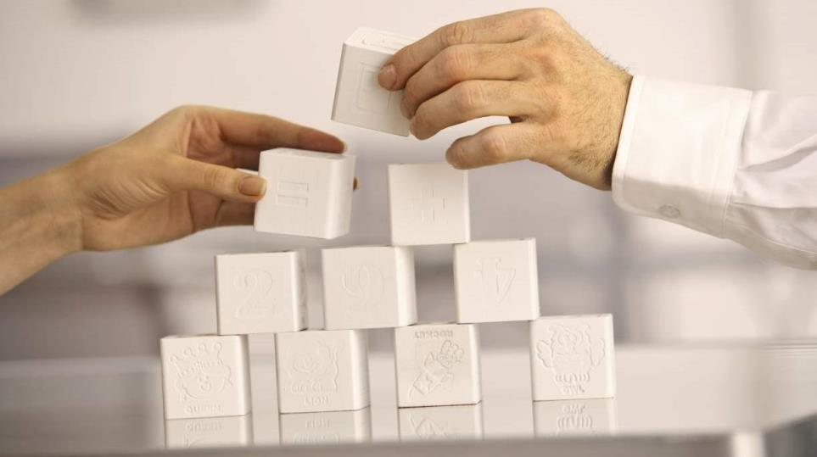

Enabling the software-defined data center
Steve Oakley
Enterprise Solutions Consultant - Dell
September 2015

Slide 2



Change: The only constant
2009
2014
The future
25%
40%
??
Internet users worldwide
2.5M
500M
??
Tweets per day
800K
PETABYTES
4400K
PETABYTES
??
Size of the
digital universe
Notes:
// KEY POINTS //
There have been significant changes in the world in recent years.
Much like no one could have predicted such swift, massive change, no one can predict what’s to come, either.
// SCRIPT //
It’s been said that change is the only constant, and this is very true today. Look at how much the world has changed in just five years, especially as it relates to technology. Just 5 years ago, only about 25% of the world was on the Internet; now it’s closer to half. We have new ways of communicating — like Tweeting. 500 million Tweets per day — covering the gamut of breaking news, brands and products, and even what we ate for breakfast. And as our world becomes increasingly connected and there are more routes to quicker, easier, richer communication, the digital universe is expanding at a rapid pace, too.
The point here is, who could have foreseen such swift, massive changes just a few years ago? And on that note, who can predict what’s to come? The answer is: No one.
// REFERENCES //
http://www.internetlivestats.com/internet-users/. 5/9/15.
http://www.internetlivestats.com/twitter-statistics/#trend. 5/9/15.
A) http://www.emc.com/collateral/analyst-reports/idc-digital-universe-are-you-ready.pdf. 5/9/15. B) http://www.emc.com/leadership/digital-universe/2014iview/executive-summary.htm. 5/9/15.
// CONTACT //
eve-marie_lanza@dell.com
// RETAIN THIS ICON LICENSING INFORMATION //
<div>Icons made by <a href="http://www.flaticon.com/authors/freepik" title="Freepik">Freepik</a> from <a href="http://www.flaticon.com" title="Flaticon">www.flaticon.com</a> is licensed by <a href="http://creativecommons.org/licenses/by/3.0/" title="Creative Commons BY 3.0">CC BY 3.0</a></div>
<div>Icons made by <a href="http://www.flaticon.com/authors/freepik" title="Freepik">Freepik</a> from <a href="http://www.flaticon.com" title="Flaticon">www.flaticon.com</a> is licensed by <a href="http://creativecommons.org/licenses/by/3.0/" title="Creative Commons BY 3.0">CC BY 3.0</a></div>

Slide 3

The CIO paradigm
Business priorities
Technology priorities
Deliver business results
to shareholders
Improve customer satisfaction & innovate
Cut/maintain costs
Keep us competitive
Improve employee productivity
“Keeping the lights on”
Manage current workloads
Application rationalization
HW updates & migrations
Reduce costs
Protect our data
Accelerating the business”
Optimize workloads
Software-defined X
Utilize new IT benchmarks
Deliver ubiquitous mobility
Implement cloud computing
Notes:
// KEY POINTS //
IT leaders must now shift focus from technology priorities to business priorities.
These priorities require different competencies and capabilities.
// SCRIPT //
From the perspective of the IT organization, there’s another challenge that is primarily internal. As technologies and IT are enabling the business and giving them a competitive advantage, CEOs are turning more toward CIOs to be the business experts. This is a shift from previous norms when IT used to be singularly focused on technology priorities. When times were different, IT teams became sophisticated technology shops. Now, as priorities are shifting, what we’re seeing is the sophistication of an average IT shop is actually going down—they have simply not been geared toward the business priorities and need to build the acumen.
In this environment, it’s even more important to work with a solution provider—more than just a product vendor—that has the technology capability as well as the business-oriented expertise to help CIOs make the transition successfully from technology priorities to business priorities.
// CONTACT //
eve-marie_lanza@dell.com
// RETAIN THIS LICENSING INFORMATION //
<div>Icons made by <a href="http://www.flaticon.com/authors/freepik" title="Freepik">Freepik</a> from <a href="http://www.flaticon.com" title="Flaticon">www.flaticon.com</a> is licensed by <a href="http://creativecommons.org/licenses/by/3.0/" title="Creative Commons BY 3.0">CC BY 3.0</a></div>
<div>Icons made by <a href="http://www.flaticon.com/authors/freepik" title="Freepik">Freepik</a> from <a href="http://www.flaticon.com" title="Flaticon">www.flaticon.com</a> is licensed by <a href="http://creativecommons.org/licenses/by/3.0/" title="Creative Commons BY 3.0">CC BY 3.0</a></div>

Slide 4
Which approach gives you better results?
New
proprietary
solutions
The
Future-Ready
Enterprise
Decreasing operating costs
A scalable, end-to-end
approach that delivers:
Closed management stack
Limited interoperability
Lock-in penalty
Rapid time to value
Superior ease of use
Unrivaled flexibility to adapt
Initial
costs
Ongoing
Cost
Initial
costs
Ongoing
Cost
Increasing
acquisition costs
Decreasing
acquisition costs
Legacy
systems
Commodity
systems
Initial
costs
Ongoing
Cost
Initial
costs
Ongoing
Cost
Complex and monolithic
High cost-per-transaction
Proprietary to one vendor
Hardware with no value added
Technology transition issues
Limited vendor support
Increasing operating costs
Notes:
// KEY POINTS //
There are competing paths available to customers, each with their own trade-offs.
Dell offers a different path which delivers maximum value, flexibility and choice as you evolve.
// SCRIPT //
Here’s the value Dell delivers to you.
We believe there are four types of solution providers. In the bottom left are the legacy system providers. Besides the fact that the initial cost of all of those highly monolithic legacy stacks are extremely expensive, the ongoing maintenance of those is also extremely expensive. And those legacy stacks don’t allow you to take advantage of all the innovation that exists in the industry today. Companies like HP and IBM have massive legacy businesses they’ve held for years.
Then, in the top left, are the new proprietaries. They use x86 standards-based architectures however they have inherent lock-in. In order to deploy UCS from Cisco, for example, everything in your environment has to be ripped out and replaced—from the racks, servers, storage, even the cables! While they promise lower ongoing costs, they are extremely cumbersome and expensive to deploy in your environment. And, again, are you willing to trust one vendor with one technology and expect them to out-innovate the market constantly?
On the bottom right side is the new breed of commodity system providers. Those options are less expensive from an acquisition cost standpoint, however once you start deploying the technologies, you quickly realize the entire deployment and management is 100% on you. What tends to happen is the ongoing cost becomes extremely expensive and the process in total becomes very cumbersome.
The reason we believe we are different is because we can strike a balance between initial costs and your ongoing costs. This is due to the design tenets we discussed—a standards-based approach, open architectures, modular systems that enable you to flexibly scale—which we strongly believe are very different from anybody else in the IT industry today.
We’ve talked about Dell’s philosophy and our value strategy that can help you power your enterprise now and in the future. Now let me give you the attributes of the Future-Ready Enterprise.
// FOR MORE INFORMATION //
Dell Advantage Conversation Guidebook: https://dell.gosavo.com/Document/Document.aspx?id=35529715&view=&srlid=35672307&srisprm=False&sritidx=0&srpgidx=0&srpgsz=19
// CONTACT //
eve-marie_lanza@dell.com

Slide 5
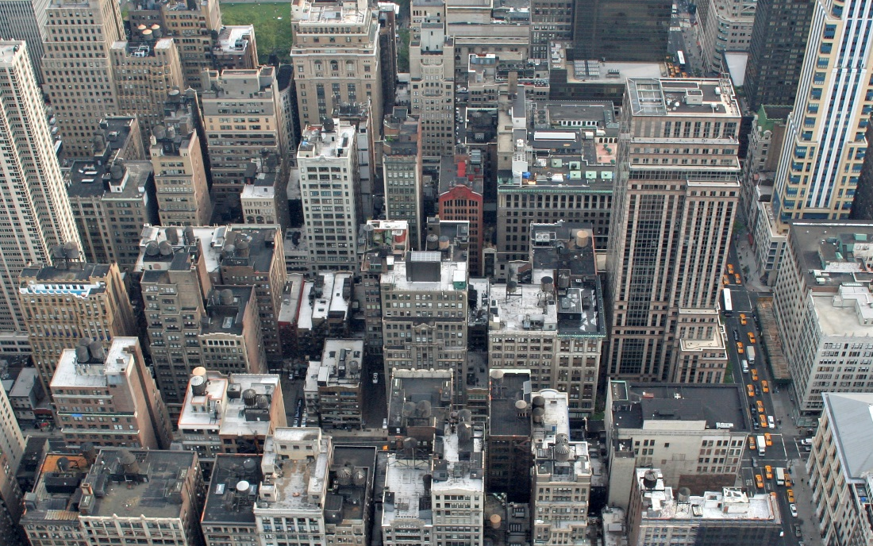

Now you can synthesize traditional and new IT
Traditional IT
New IT
Support traditional IT applications and architectures with efficient and scalable virtualization-based
cloud solutions
Support new IT applications and architectures with efficient, scale-out, hyperscale- inspired cloud solutions
Future-Ready
IT
A common compute-centric, software-driven platform for traditional and new
Notes:
// KEY POINTS //
Dell believes that customers should not have to make “either/or” choices.
We believe in a single infrastructure that supports both modes so that the benefits of both modes can be realized without adding siloes and complexity.
Our Future-Ready IT solutions provide a common platform for traditional and new.
// SCRIPT //
Our goal is to avoid the traditional/new split going forward, and that compute-centric and software driven architecture we are developing is key. We believe that a singular IT infrastructure architecture can support both, and provide a much lower total cost of ownership overall. Leveraging the emerging software-defined data center technologies from our partners, combining that with our new infrastructure hardware designs delivers a superior “Future Ready” approach that preserves all of the benefit of our virtualization and consolidation efforts of the past half-decade while simultaneously supporting new IT architectures with hyperscale inspired efficiency.
// REFERENCES //
http://intranet.dell.com/marketing/globalcreative/Brand%20Photography/Forms/DispForm.aspx?ID=283&Source=http%3A%2F%2Fintranet%2Edell%2Ecom%2Fmarketing%2Fglobalcreative%2FBrand%2520Photography%2FForms%2FAllItems%2Easpx&RootFolder=%2Fmarketing%2Fglobalcreative%2FBrand%20Photography
https://xau.enfatico.com/PORTAL/MVIEW.php?spreadnumber=0&id=694611&path=/raid/global-asset-library/Dell/Lifestyle/Without_Product/Places/Outdoors/Getty_102373988.psd&server=MTUyLjE0Ni44Ny40Ng==&siteurl=
// CONTACT //
eve-marie_lanza@dell.com

Slide 6
Shift your focus from infrastructure to service
Enterprise applications & workloads
Server
Storage
Networking
Software
Orchestration stack
Management
Multi-vendor, cross-platform
unified management
Infrastructure control
IT silos
Open standards-based hardware
Management

Slide 7
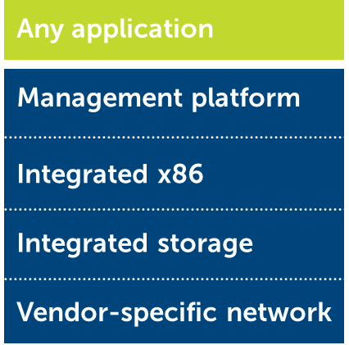
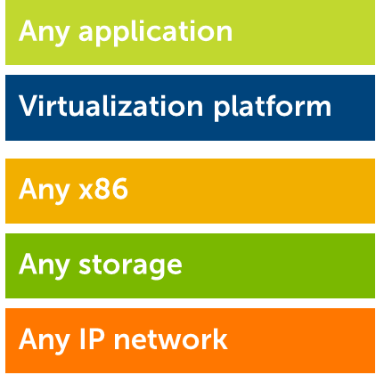
SDDC delivers needed agility and efficiency
Benefit | Hardware-defined (HDDC) | Software-defined (SDDC)
Innovation | Slow Long hardware/ASIC cycles | Fast Rapid software innovation
Flexibility | No Lock-in | Yes Choice of infrastructure
Ease of insertion/ deployment | Low Requires forklift upgrade | High Non-disruptive

Slide 8
Evolution strategy
Embrace your legacy, control your destiny
IT Evolution
Future-Ready IT Design Tenets
Best-of-breed systems
System of systems
Software-defined networking
Software-defined storage
Server-centric, software-defined
systems
Integrated
  Built on open standards, making it quicker and easier to adapt
Modular
  Cost-effectively scales up, down, or out as needed
Automated
  Simplifies IT operations and service delivery
Software-defined | Hardware-accelerated | Standards-driven

Slide 9
Enabling the unified data center
Workload
Management
IT
services
Private
cloud
Enterprise
applications
Desktop
virtualization
Virtualization
IT services
ecosystem
Dell
Software
3rd
Party
Server
Storage
Automationengine
Active System Manager
Network
Virtualization
Integrated
infrastructure
Server
Storage
Networking
Converged

Slide 10
The building blocks
Software-defined storage
Software-defined networking

Slide 11

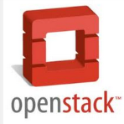


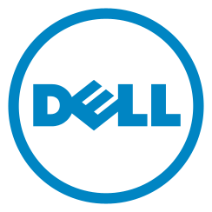






Enabling the Future Ready Enterprise
Workload ready + virtual infrastructure ready + software-defined & cloud ready
Software-Defined Computing
Software-Defined Storage
Software-Defined Networking
Notes:
Utilizing Open, Standards-Based Hardware
And Disaggregating the hardware from the
Supporting Software-Defined Overlay

Slide 12





The future of SDS is flexible
Enterprise-class infrastructure
Optimized hardware & monitoring
Appliances & bundled solutions
End-to-end solution architectures
Global services & support
Dell
Enterprise-class infrastructure
Optimized hardware & monitoring
Appliances & bundled solutions
End-to-end solution architectures
Global services & support
Global services & support
Storage
Spaces
VSAN,
EVO:RAIL

Slide 13
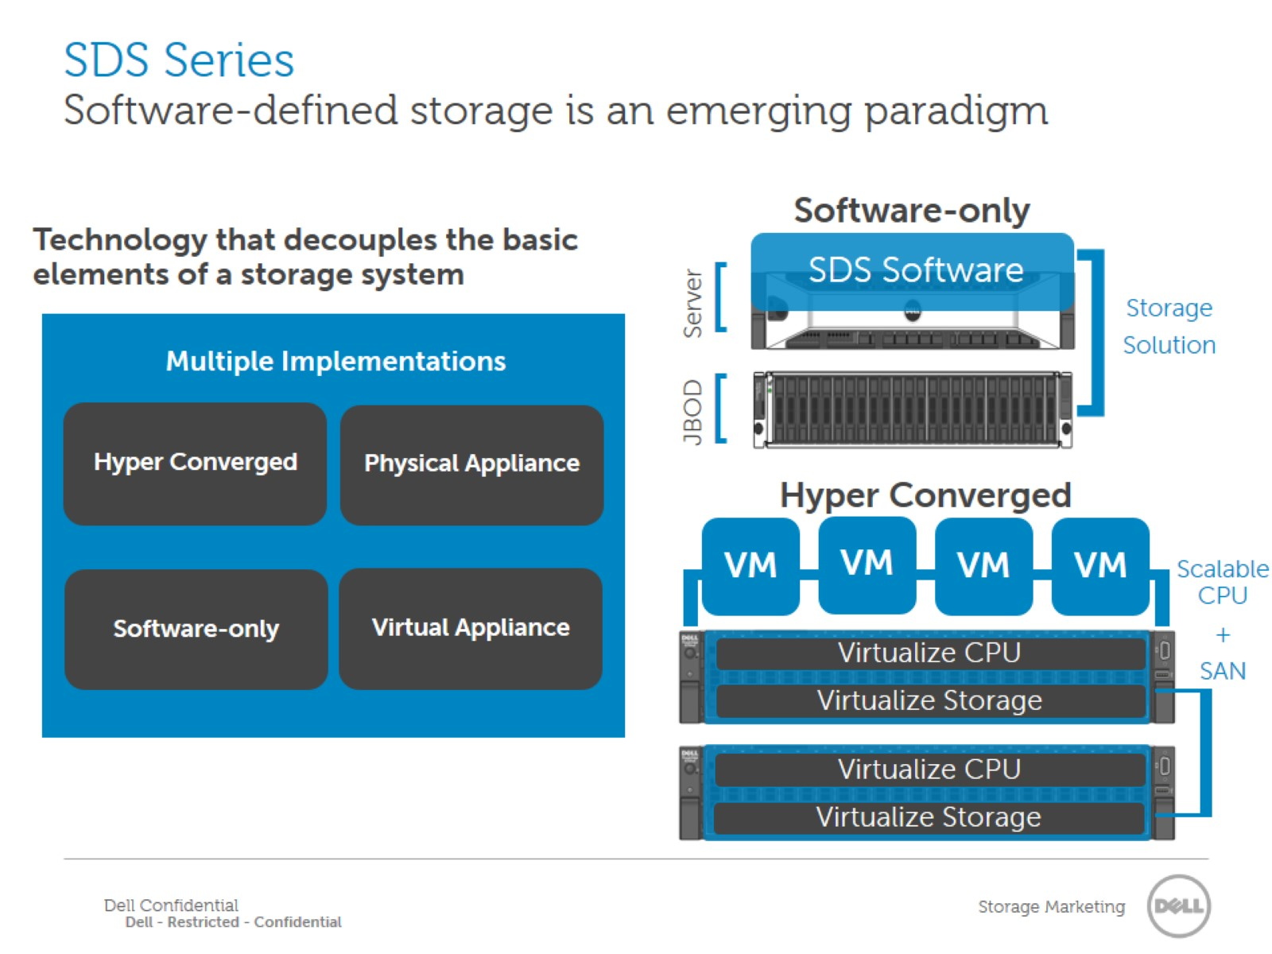
SDS Series
Software-defined storage is an emerging paradigm

Slide 14

Evolve storage
Hypervisor- based
Vmware, Microsoft, Open Stack
Fluid Cache for SAN
Software- defined storage
X86 Based
Performance- Intensive
Dell XC powered by
New paradigm
Notes:
The value proposition of SDS really varies by business objective but can be categorized in 3 simple buckets:
Improving performance by putting data closer to the server (performance-intensive)
Building on existing investments (evolving data center)
Leveraging x86-based servers as building blocks (new paradigm)
Performance intensive
Mission-critical data gets placed closest to the server removing any latency. This maximizes the performance across the data which in turn delivers better business results by simply performing faster.
highlight fluid cache for SAN; talking about that traditional SANs still have a place
Evolving data center
Builds on existing infrastructure. For most business, ripping their existing infrastructure and replacing with the “newest, latest and greatest” simply isn’t an option. You’ve likely spent years investing in infrastructure, training an organization to be proficient with the software and applications…and you need to further optimize that environment. This requires building upon existing investments, and SDS is the natural evolution of the datacenter. In many cases, the storage architecture of today is heavily software-focused already, and many even ask if their existing solutions are “software defined”…further proving this point.
talk about converged, talk about VMware/MS offers (vSAN, spaces)
New paradigm
With the growth of unstructured data and declining budgets, there is demand for low-cost infrastructure that can intelligently create pools of storage resources. This type of solution would better match the non-mission critical data that many are storing at a higher storage tier today.
Discuss how growth of unstructured data means you need cost-optimized solutions; highlight Nextenta, OpenStack and Hadoop, Dell focus on innovation with OpenSource

Slide 15






Choose your software-defined networking approach
Overlay /Hypervisor
Solutions
Vmware, Microsoft, Open Stack
Open standards +
Open protocols +
Open source =
Open IT with choices
Open
Networking
Dell Networking
Software-Defined Networks
TCL, Perl & Python scripting
REST-API, XML, OMI, Puppet, Chef
SDN Controllers
Open Standards, Open Source
Programmable Solutions
Controller
Solutions

Slide 16
The future of SDN is Open
Open Networking
Traditional approach
Standard orchestration
and automation tools
Proprietary architectures & mgmt tools
Optional 3rd party SDN / NVO controller
Hundreds of protocols
Dell
Any OS
Global services & support
Proprietary OS
(e.g., Cisco IOS, Jun OS)
Open standard hardware
Proprietary ASICs
Merchant silicon

Slide 17
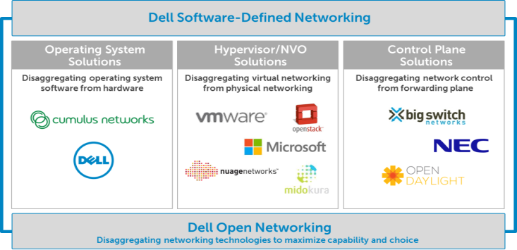


Software-Defined Networking in the data center
Powered by Open Networking, choice + innovation

Slide 18
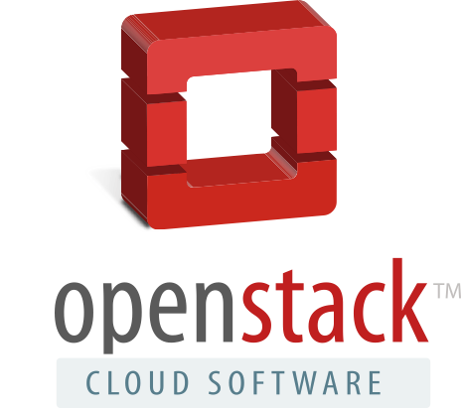




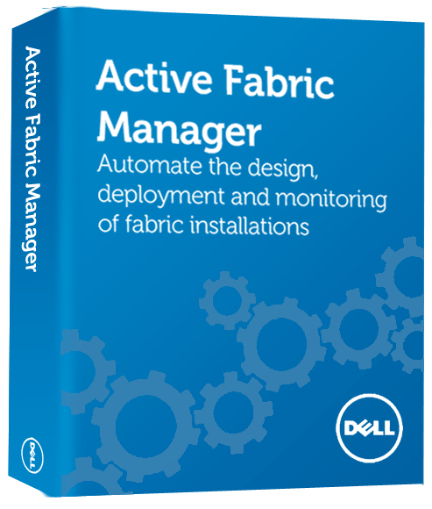
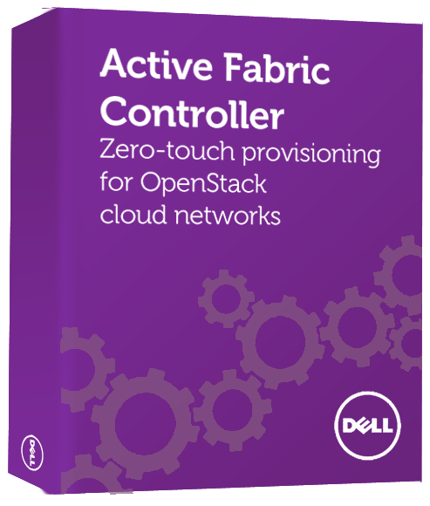





Dell Networking data center strategic framework
Open Networking: choice & innovation
Application/Cloud
environment
Automation &
Programmability
Other
NVO/Controller
software
Plus partners
Management &
Orchestration
Open system
software
Dell Networking
Software
Plus open ecosystem for
OS and L4-7 services
Plus partners
Standards-based
hardware
Dell M-Series, FN-Series
S-Series, Z-Series
Dell PowerEdge servers
and converged systems
Monitoring
Merchant
silicon
Plus partners
Integrated solutions
for SMB & mid-market
Disaggregated solutions
for large enterprise & carriers

Slide 19
Enabling SDDC in your data center
    Prioritize SDDC plans
      Watch for business needs that require flexibility, “carving out” of resources, and rapid, dynamic response
1
    Maintain agility
      Stay open so you can leverage the technology you want, when you want
2
    Choose the right partner
      Ensure your solution provider is committed to your needs, so when challenges arise, your outcome is assured
3
Notes:
Prioritize SDDC plans
Watch for business needs that require more IT flexibility, “carving out” dedicated resources, and dynamic, rapid-response capabilities.
Maintain agility
Ensure any solution you consider gives you the freedom to leverage the technology you want, when you want—not what a vendor dictates.
Choose a committed partner
Work with a solution provider who understands your needs as well as emerging technologies, so when unexpected challenges arise, your outcome is assured.

Slide 20
Thank you

